Slide 1




CT-216
LDPC DECODING
FOR 5G NR
Lab Group: 3
Project Group: 17
Under the guidance of: Prof. Yash Vasavda
Mentor TA: Akshat Jindal

Slide 2

Honour Code
We declare that
The work we are presenting is our own work and we have not copied the work (Matlab code, results, etc.) that someone else has done.
Concepts, understanding and insights we will be describing are our own.
Wherever we have relied on an existing work that is not our own, we have provided a proper reference citation.
We make this pledge truthfully, knowing that violation of this solemn pledge can carry grave consequences.

Slide 3


OVERVIEW
Brief Introduction about LDPC codes and 5G NR
Base Graph Analysis
Parity Check Matrix from the Base graph
Rate Matching
Encoding
Hard Decision Decoding
Soft Decision Decoding
Result
Conclusion

Slide 4
Brief Introduction About LDPC Codes and 5G NR
Low-density parity check (LDPC) codes are a class of error correction codes introduced by Robert G. Gallager and are thus known as Gallager codes.
LDPC codes functionally are defined by a sparse parity-check matrix.
These are a type of linear error-correcting code that can achieve near Shannon limit performance.
LDPC codes are used in new-generation wireless communication standards called 5G NR (New Radio).

Slide 5


1
Base Matrix
Random Message
2
Parity Check Matrix
3
Encoded Message
Model for 5G NR LDPC
4
BPSK Modulator
5
AWGN
6
Received Message
6
Hard Decision Decoding & Soft Decision decoding

Slide 6
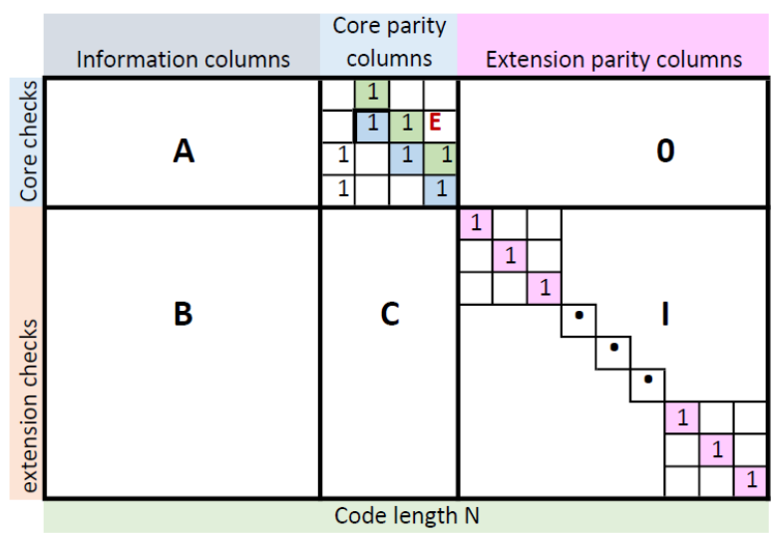
There are two kinds of base graphs, and their usage is determined by code rate and size of information bits.
BG 1 - 46 x 68
BG 2 - 42 x 52
For an m x n sized base graph, the number of message bits is determined as k = m - n.
So, base graph 1 has a maximum of 22 information bits.
Base graph 2 has a maximum of 10 information bits.
For base graph 1:
A is a 4 x 22 matrix; E is a 4 x 4 matrix; 0 is a 4 x 42 zero matrix
B - 42 x 22 matrix; C - 42 x 4 matrix; I - 42 x 42 identity matrix
For base graph 2:
A is a 4 x 10 matrix; E is a 4 x 4 matrix; 0 is a 4 x 38 zero matrix
B - 38 x 10 matrix; C - 38 x 4 matrix; I - 38 x 38 identity matrix
The matrix ‘E’ possesses double diagonal structure which is beneficial for encoding.
Base Graph Analysis

Slide 7
Parity Check Matrix Generation
In order to construct the parity check matrix, H, from the base graph, we use Z, the expansion factor or the lifting size. Each element of the base graph is replaced by a z x z matrix according to the following rules:
Every -1 in the base graph is replaced by an all-zero matrix of size z x z.
Every 0 in the base graph is replaced by an identity matrix of size z x z.
For the base graph with an expansion factor of z, each element can be of any value from -1 to z-1. Each element of value from 1 to z-1 (p[i][j]) is replaced by a circular permutation matrix I of size z x z. In this case, I is obtained by circularly shifting the identity matrix of size z x z to the right p[i][j] times, where p[i][j] is the value of the element in the base graph.
Advantage of using circularly shifted matrices is to reduce the memory requirement and it can also facilitate the use of simple switch network of encoding and decoding.

Slide 8
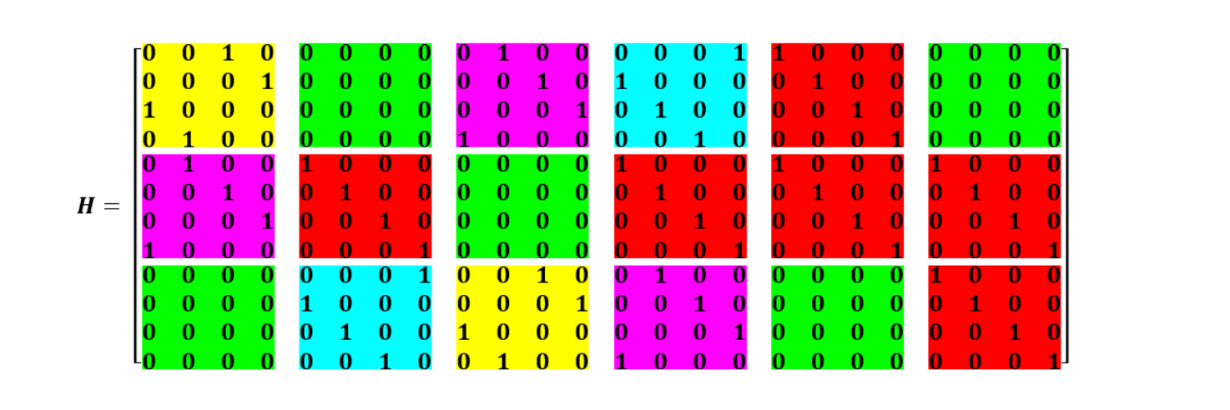
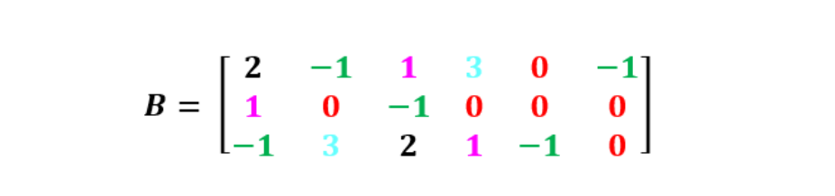
Example
As shown in the figure, consider a base matrix with Z=4.
In order to convert it into an H matrix, we replace all 0's with a 4 x 4 identity matrix.
The other elements of the matrix are replaced by circularly right-shifting the identity matrix depending on the value of that element.

Slide 9
Rate Matching
Rate matching is the process of selecting a specific number of bits from the parity matrix in order to meet the needs of transmission over a channel.
The purpose of rate matching is to adapt different code rates.
In 5G NR, LDPC base graphs define a large number of encoded bits (codeword length), but often only a subset is transmitted, based on the targeted rate.
Rate matching can be achieved by any of the following ways:
Puncturing
We do not transmit certain bits after encoding.
Shortening
Suppose we have an m x n base matrix and an expansion factor of z. The length of the transmitted codeword is n * z.
Out of these n*z bits, the first 2z bits are always punctured. So, (n-2)*z bits will be left.
The number of message bits will be (n-m)*z.
To understand this in a better way, let us consider an example in the next slide.

Slide 10

Example
Consider a base matrix of size 46 x 68 as shown in the figure.
The number of parity bits after expansion will be 46z bits.
With 2z bits punctured, the length of the code word will now be equal to 68z-2z=66z
In this case, the rate will be 1/3, as the number of message bits is (68-46)*z=22z bits.
Now, to achieve a rate of 1/2, we can transmit the first 44z bits, thus puncturing the last 22z bits and using only 24z from the parity block.
In this case, effectively we use only the first 24 rows of the base matrix. So, 24 x 46 left-top part of the matrix will be used.
To achieve an even higher rate, say 2/3, we have to transmit 33z bits in total (20z message bits + 13z parity bits). In this case, we puncture the last 33z bits.
68
46
46Z bits after exp.
2Z bits
22z bits

Slide 11
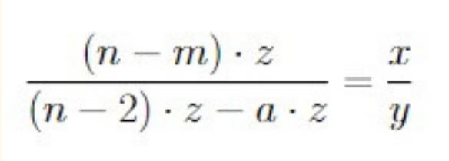
Rate Matching
In general, suppose we want to achieve a code rate of x/y.
Assume that we have punctured a*z bits out of the available (n-2)*z bits.
The number of parity bits required can be computed from the equation shown
.
Here the required size of the H matrix will be
Number of rows = Number of parity bits which we get from the above equation.
Number of Columns = Number of columns from eq. + 2.

Slide 12
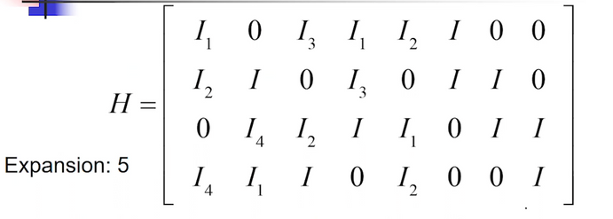


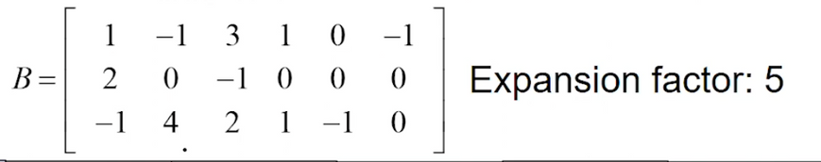
Encoding Using Base Matrix
In order to encode the message vector, we make use of the parity check matrix H, generated from the base matrix.
The parity bits of the encoded codeword can be simply found by solving linear equations. As mentioned earlier, the double diagonal structure of the base matrix makes this task easier.
We use the fact that H⋅CT=0 where C=[m1 m2 . . . . mk p1 p2 . . . . p(n-k) ] is the encoded codeword if there are size of the matrix H is k x n.
To understand this, we consider the following B matrix with Z=5. The corresponding parity check matrix is also shown:
Double Diagonal structure
As shown here, each element of the base matrix is replaced by a 5x5 matrix. Here, Ik denotes a 5 x 5 identity matrix shifted circularly right by k times.
We consider that message m=[m1 m2 m3 m4], where each mi is of 5 bit and p=[p1 p2 p3 p4 ] where each pi is of 5 bit.
Solving for H⋅CT=0, we get the following equations:

Slide 13
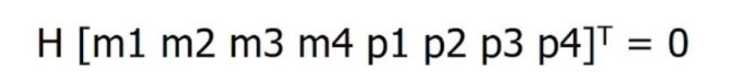
The equations obtained are as follows:
I1 m1 + I3 m3 + I1 m4 +I2 p1 +Ip2 =0. (1)
I2 m1 + I m2 + I3 m3 + I p2 +Ip3 =0 (2)
I4 m2 + I2 m3 + I m4 +I1p1 +Ip3 + Ip4=0 (3)
I4 m1 + I1 m2 + I m3 +I2 p1 +Ip4 =0 (4)
Now, adding the above four equations with mod 2 operation, we get the following equation:
I1 m1 + I3 m3 + I1 m4 + I2 m1 + I m2 + I3 m3 + I4 m2 + I2 m3 + I m4 + I4m1 + I1 m2 + I m3 =I1 p1
Using the above equation, we can find p1.
Plugging the value of p1 in equation (1), we can p2.
Similarly, p3 and p4 can be found.
Adding the four equations cancels other terms containing p2. p3, p4 , which is due to the double diagonal structure in the part of the H matrix.

Slide 14
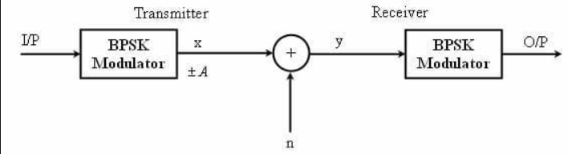
BPSK
It converts binary bits into symbols for transmission using two phases:
Bit 0 → Symbol +1
Bit 1 → Symbol –1
How it works:
Takes a stream of encoded bits (0s and 1s)
Maps them to a signal with phase shifts (like +1 and -1)
Why we use BPSK in LDPC simulations:
To prepare the encoded message for transmission over a noisy channel.
BPSK keeps it simple—only two signal levels, making it super robust against noise.

Slide 15
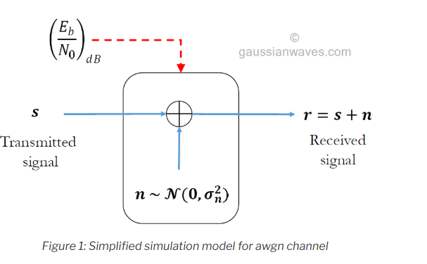
AWGN
Key Properties:
Additive: Noise is added to the signal.
White: Noise power is spread uniformly across all frequencies.
Gaussian: The noise follows a normal (Gaussian) distribution with a mean of 0 and some variance σ².
Mathematical Model:
Noise: nᵢ ~ N(0, σ²)
Received Signal: yᵢ = xᵢ + nᵢ
Noise Variance (σ):
σ = 1 / √(2 × Eb/No × r)
(where r is the code rate)
Why AWGN is used in LDPC Simulations:
It helps test how well our decoder performs in real-world noisy environments by adding controlled noise to the BPSK signal before decoding.

Slide 16
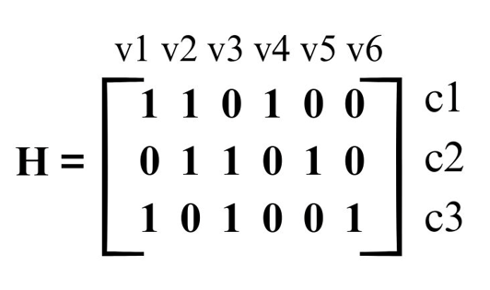
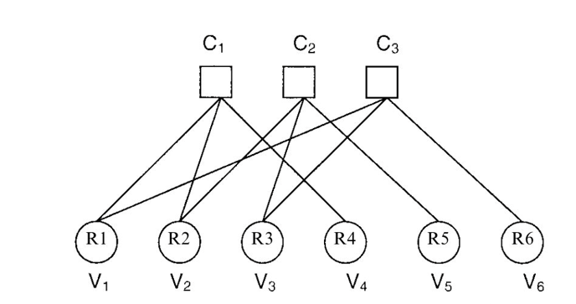
TANNER GRAPH -
A bipartite graph that represents the structure of the LDPC parity-check matrix H.
Variable Nodes (VN): Represent bits of the codeword
Check Nodes (CN): Represent parity-check constraints
Edges: Connect VNs to CNs wherever H(i,j) = 1
Foundation for Decoding
Tanner Graph is essential for organizing bit-check relationships and message-passing during decoding.

Slide 17

decoding- To introduce the core idea, we’ll first explore a simplified version based on hard decision decoding. This version is easier to understand and implement. Later, we’ll extend the algorithm to support soft decisions, which typically offer improved decoding performance.
HARD DECISION DECODING
Purpose of HDD-
Recover the original message from the corrupted channel output.
Operates over a Tanner Graph derived from the expanded H matrix (base matrix × expansion factor Z).

Slide 18

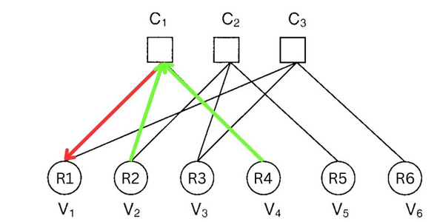
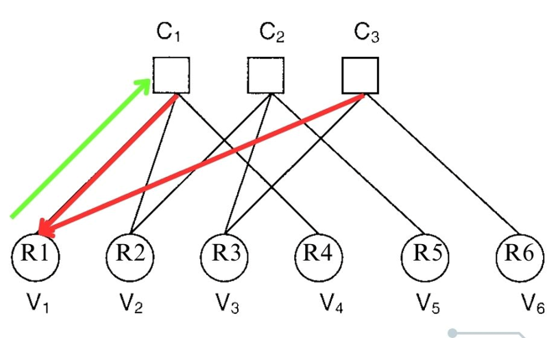
Hard Decision decoding
Using Tanner Graph
Iterative Decoding Process – Message Passing
intialization
We define two 2D matrices in our code:
VN_to_CN_msg (VN sends estimate to CN)
CN_to_VN_msg (CN sends parity correction to VN)
Convert noisy values to hard bits:
receivedBits = (noisySignal < 0)
VN → CN
VN sends majority vote (from other CNs + channel) to each connected CN.
CN → VN
CN computes parity using all other VNs and sends suggestion.
Syndrome Check:
If H * finalBits ≡ 0, decoding is complete.

Slide 19

Internal Logic of Majority and SPC Functions
Majority Decoding(VN)
SPC decoding(CN)
For each VN, count incoming 0s and 1s (from CNs).
Include original received value.
Return the majority.
For each CN, compute XOR of all connected VNs (except current).
Send updated value based on parity constraint.
Each Variable Node (VN) starts with the received channel bit and sends estimates to connected Check Nodes (CNs) using majority voting.
Each CN responds with updated estimates using SPC decoding, excluding the VN it’s sending to. Repeat this VN-CN message exchange until all errors are corrected or the iteration limit is reached.

Slide 20
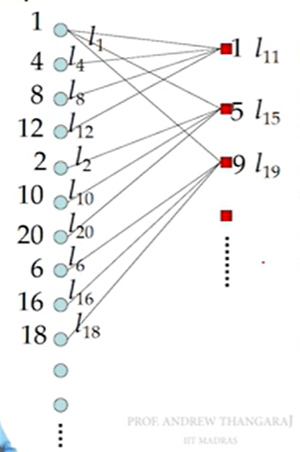
SOFT DECISION DECODING
Unlike hard decision decoding, which uses binary decisions (0 or 1), soft decision decoding utilizes probabilistic information (e.g., log-likelihood ratios) from the receiver to make more informed decoding decisions.​
In soft decoding LDPC codes can be represented using Tanner graphs, consisting of variable nodes ,VNs(representing code bits) and check nodes , CNs(representing parity-check equations).

Slide 21
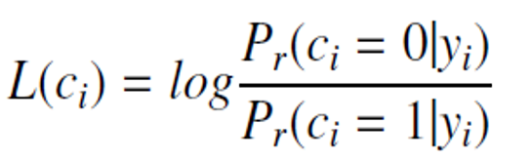
APPROACH
Since in soft decoding we need probabilistic result belief propagation algorithm is used. It is an algorithm which involves iterative message passing between variable and check nodes, updating beliefs about the transmitted bits based on the received soft information.
Two kind of beliefs are taken into account.
Intrinsic belief - what the channel tells us.
Extrinsic belief - what the rest of the code structure (via neighbors) tells us.
And for that we use LLR (log likelihood ratio). The basic equation for it is:

Slide 22
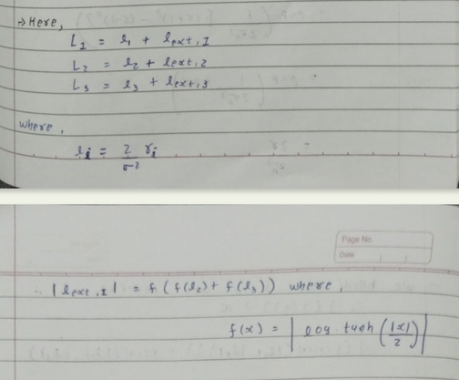
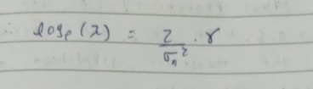
APPROACH
In the initial step, the Log-Likelihood Ratios (LLRs) are assigned to the variable nodes. Following this, each variable node begins transmitting messages to its connected check nodes. These messages are computed using the following formula.
But the using of that formula for each CN in various iterations makes the algorithm more complex.
To overcome the problem a Min-sum approximation can be used.

Slide 23
ALGORITHM IMPLEMENTATION
To implement the algorithm we make the use of sparse parity check matrix. In this matrix each row denotes a CN and each column denotes a VN. The value 1 in the matrix for (i, j) represents the existence of and edge between ith check node and jth variable node.
We use this H matrix to create a storage matrix represented by the symbol L. In L matrix all all the places where H matrix has 1 is replaced by the LLR of the received signal and 0s are kept as it is.

Slide 24
ALGORITHM IMPLEMENTATION
We initiate the message passing between variable and check nodes by applying the min-sum algorithm on every row of the L matrix. i.e. replacing every non-zero value with the minimum of all the non-zero values except the one being replaced and multiplying with the suitable parity. The minimum most value is replaced by the second minimum value of all.
For sign of all bits, we find the overall sign of the row by multiplying all the signs in the row. Then, the new sign of each element is equal to (old sign) * (overall sign).
After this message passing from check node to variable node is done by adding the values present in a column for every column. This gives us the new LLR values which can be used to determine Ĉ and by checking if H*Ĉ equals zero or not we can tell if further iterations are required.

Slide 25
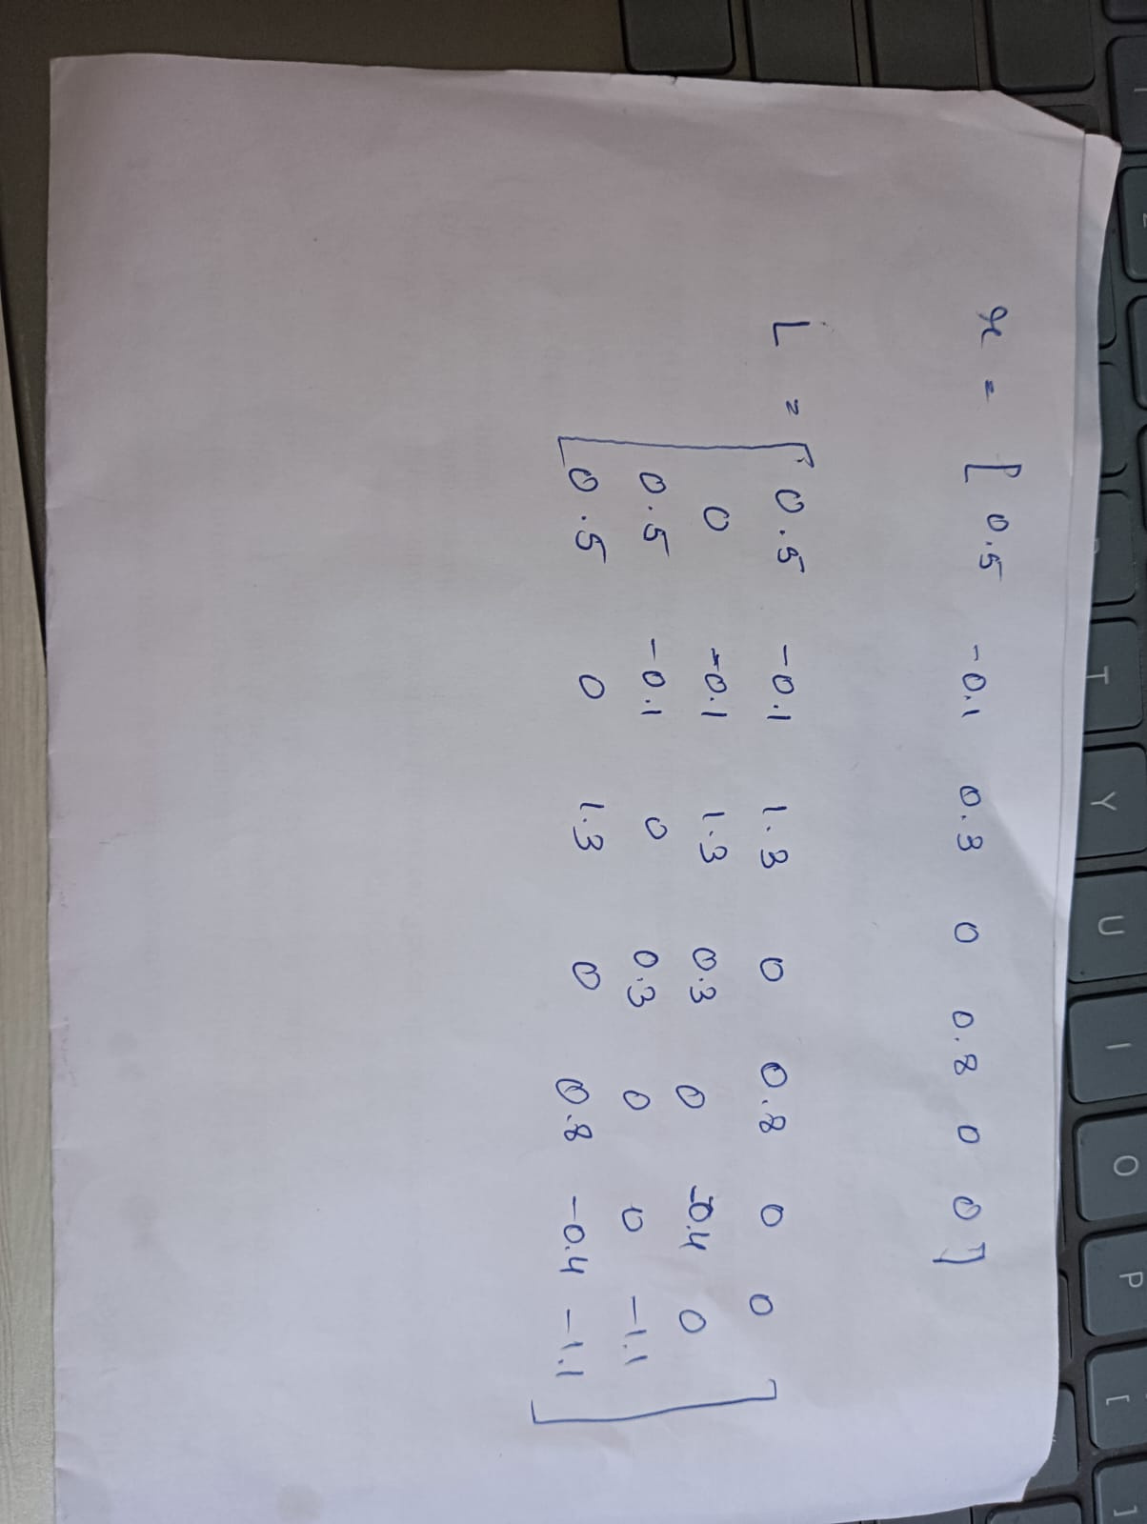
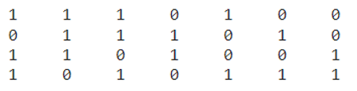
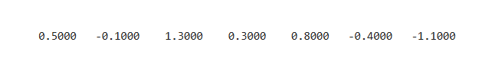
EXAMPLE
We take the following sparse H matrix.
Let the r matrix be:
This received vector r, is in the form of LLRs. So we now make the storage matrix L as follows, by plugging the values of ri s in the ith column of H matrix having non zero value:

Slide 26
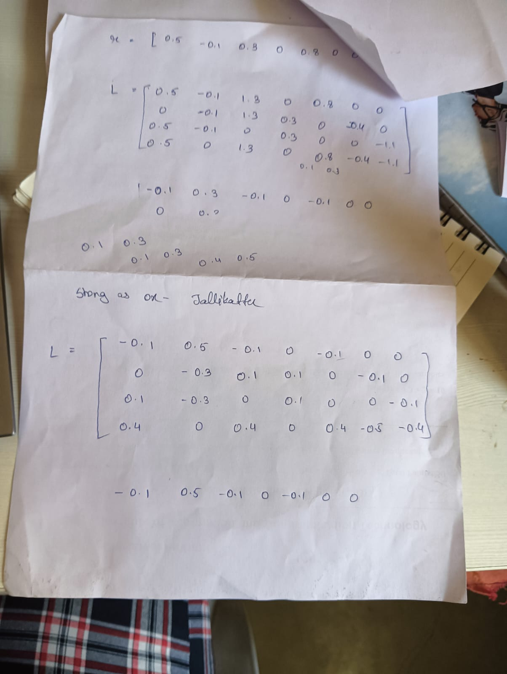
EXAMPLE
Min1 and min2 (in absolute terms) for first row of L are, 0.1 and 0.5 resp.
Replacing all the non zero values with min1 except the one with min1 and replacing it with min2. Also since the sign we get by multiplying all value is -1, we flip the sign for each value. So we get the following as per our first row of L:
Performing minsum algorithm iteratively, we finally get L as:

Slide 27
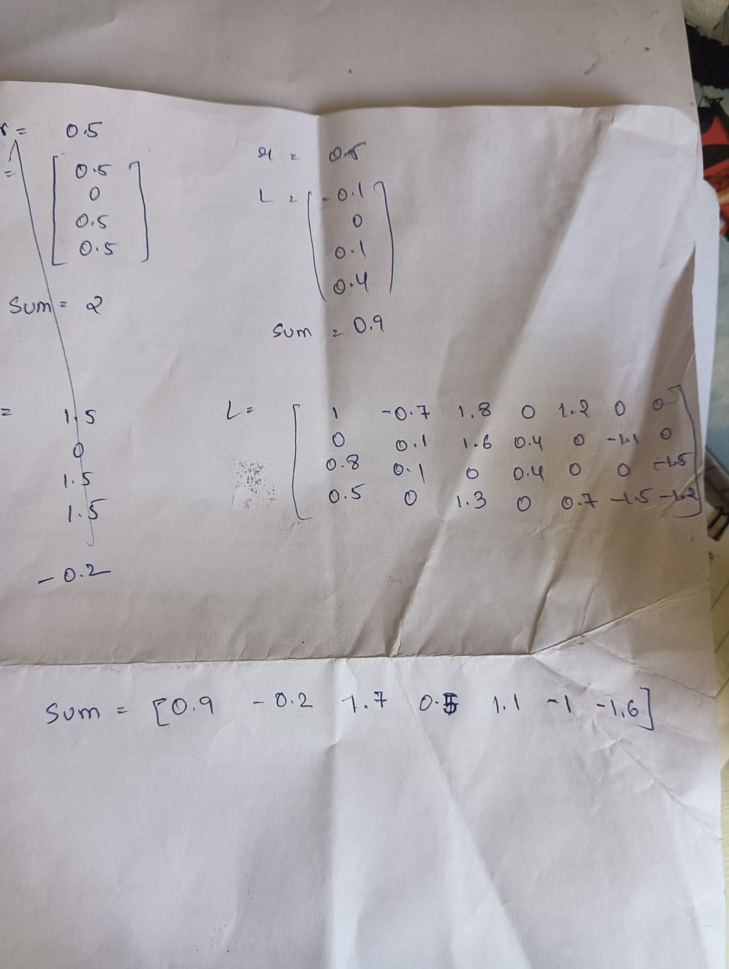
EXAMPLE
Now to get the belief of that bit,, we calculate the total sum in each column with the received bit.
The updated belief after first iteration is;
For the updated L : New entry = Total sum - Old entry

Slide 28
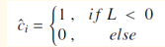
EXAMPLE
We then estimate c following the rule::
Compare this obtained c with the original message to check if it is decoded successfully or not. If not still, then we continue the loop.

Slide 29
Results of Hard Decision Decoding
for Matrix
NR_2_6_52

Slide 30
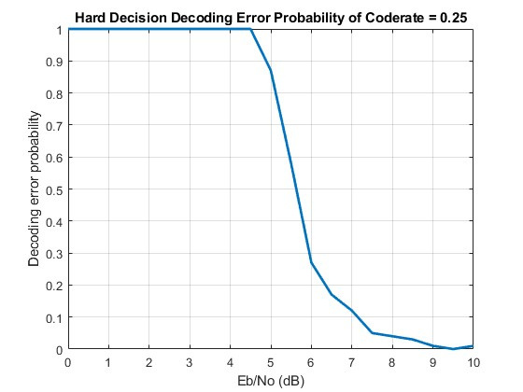
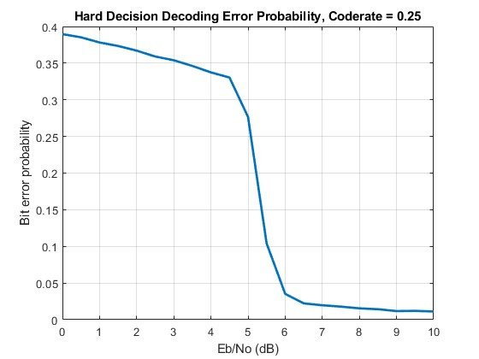
Rate = 1/4

Slide 31
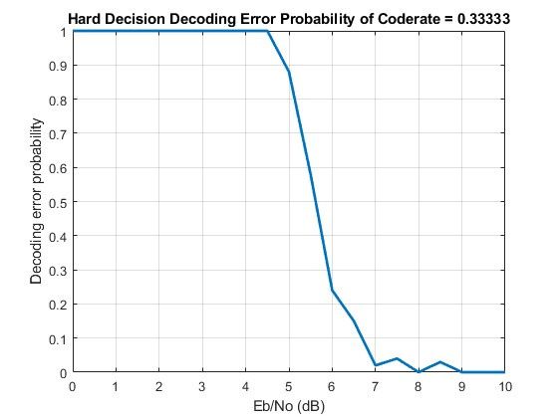
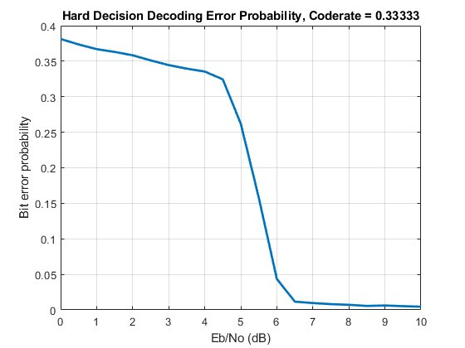
Rate = 1/3

Slide 32
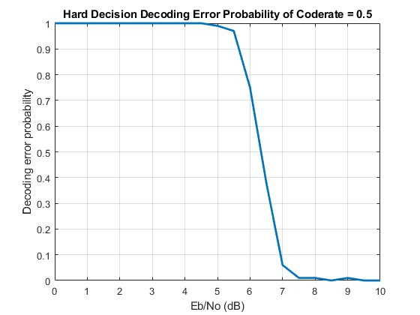
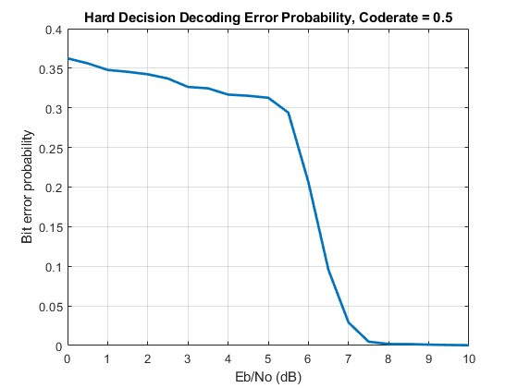
Rate = 1/2

Slide 33
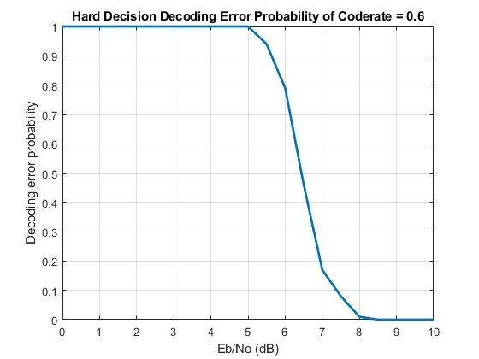
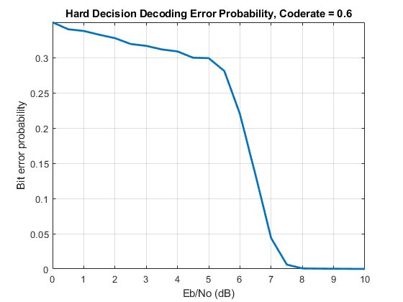
Rate = 3/5

Slide 34
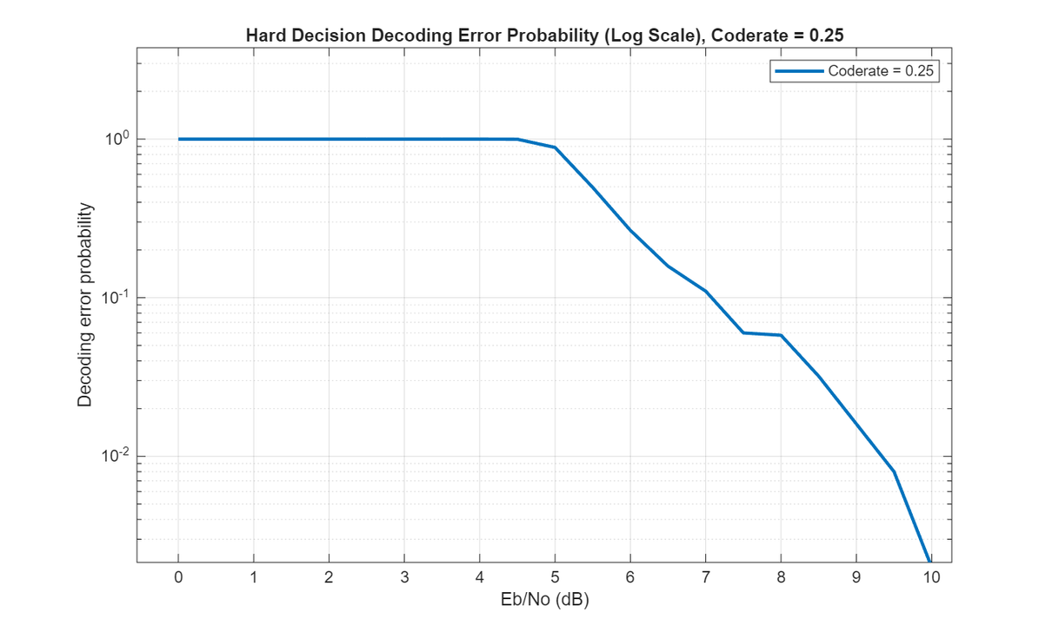
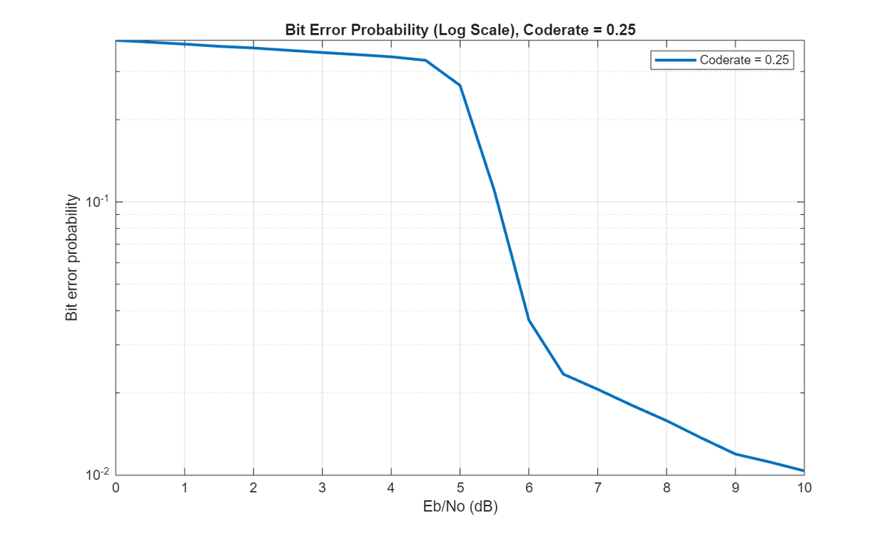
Rate = 1/4

Slide 35
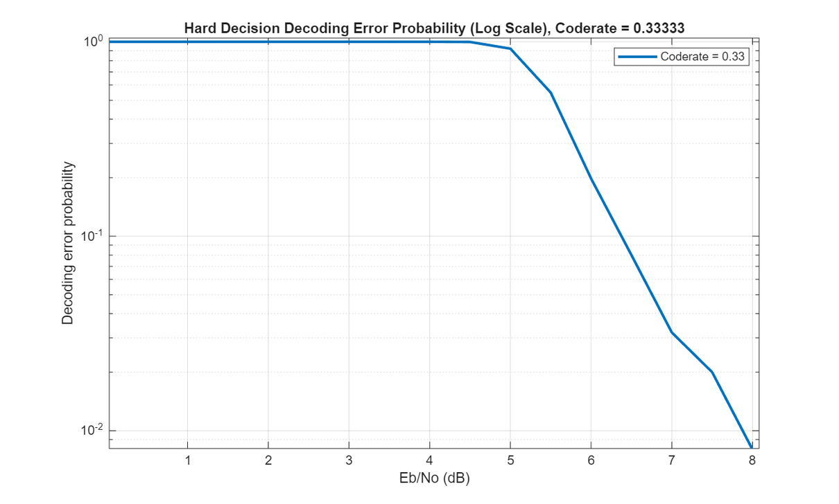
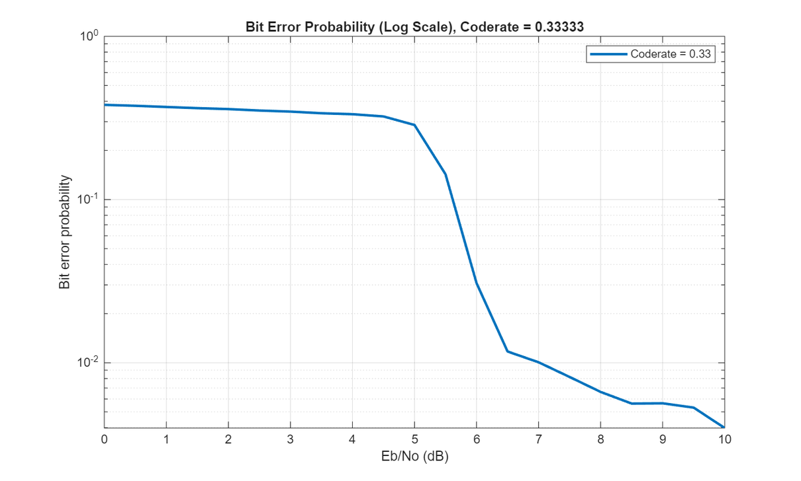
Rate = 1/3

Slide 36
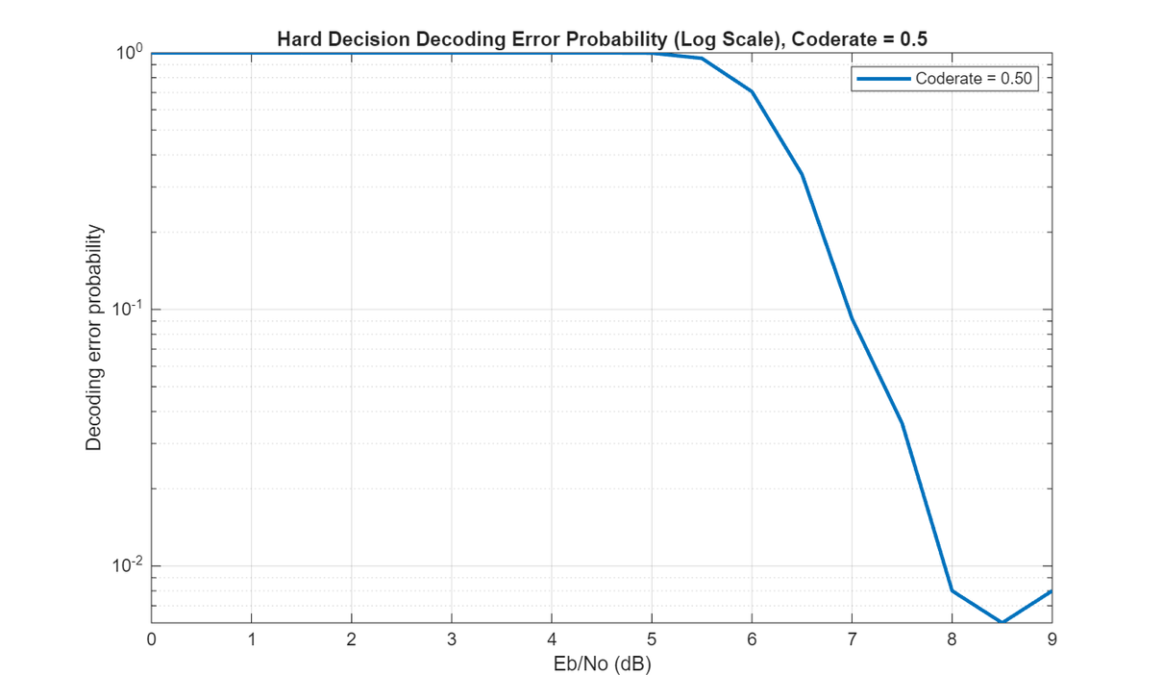
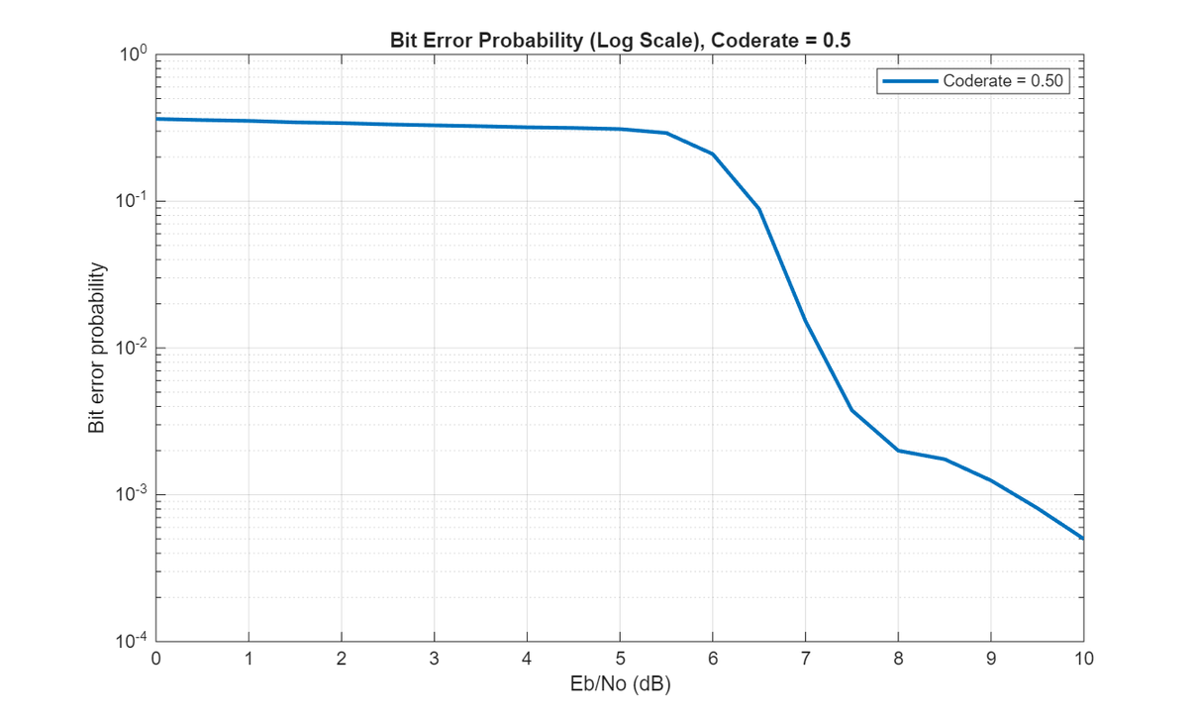
Rate = 1/2

Slide 37
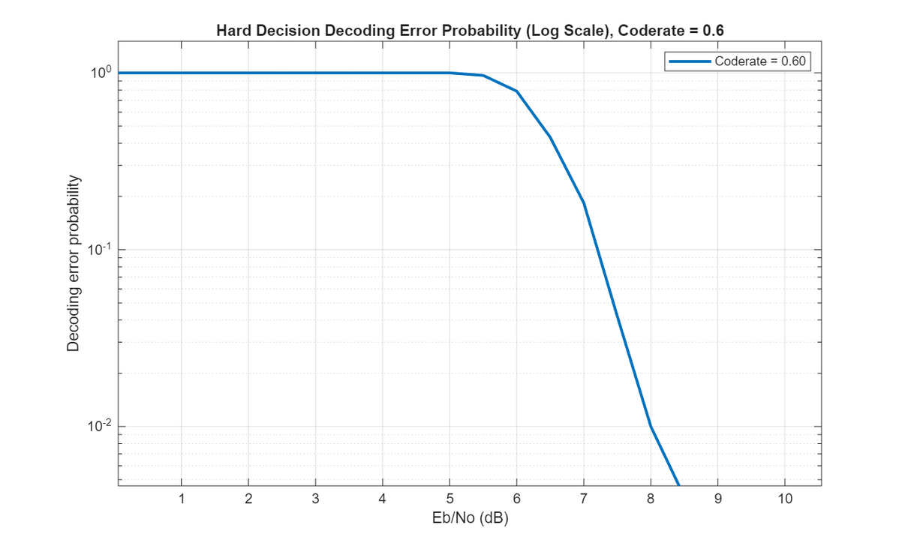
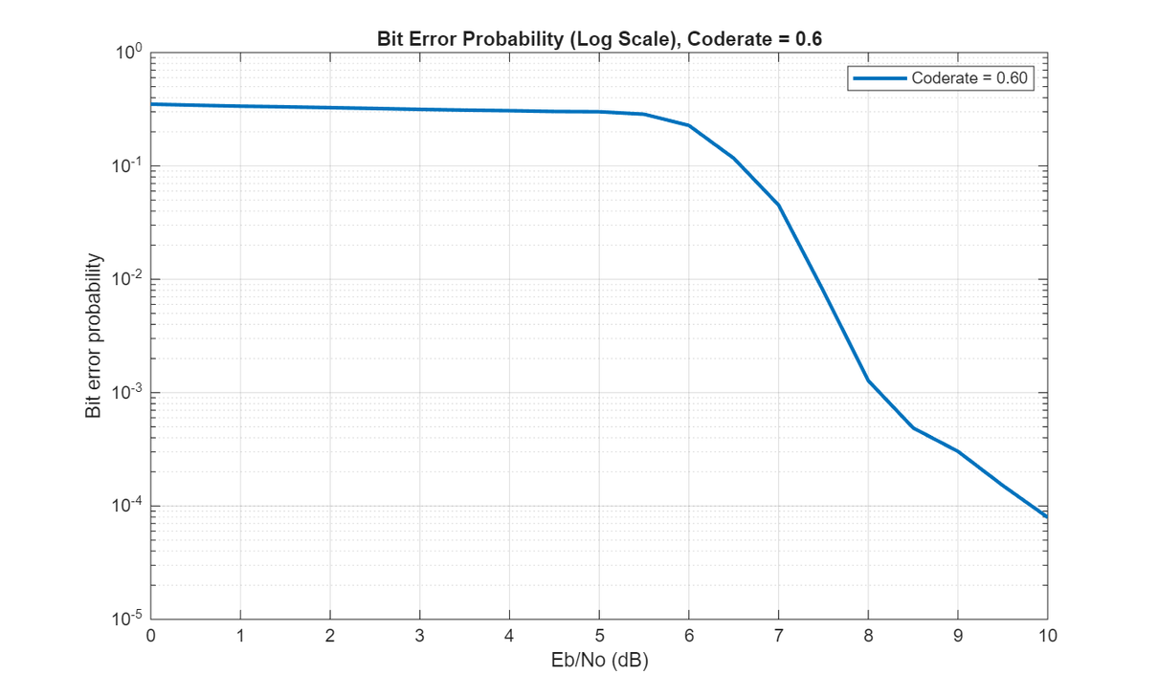
Rate = 3/5

Slide 38
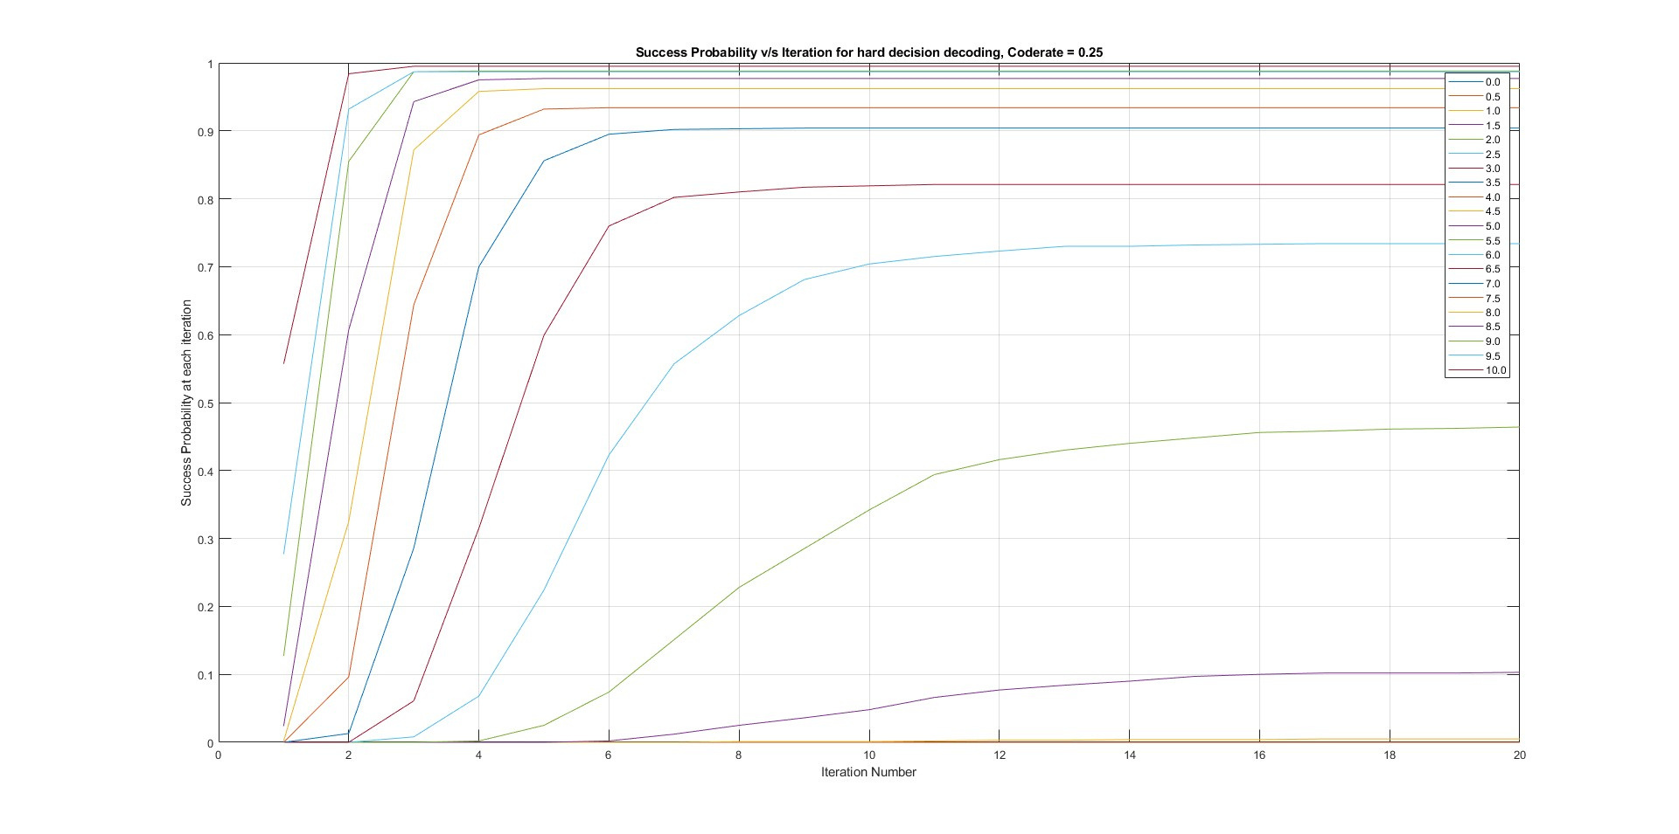
decoding success

Slide 39
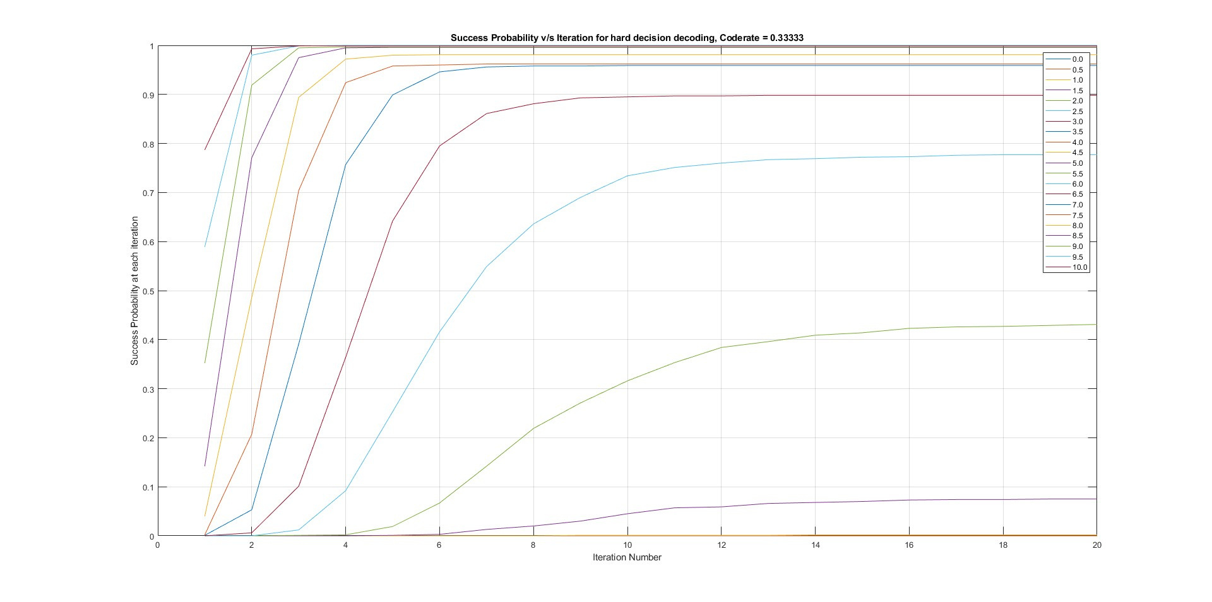
decoding success

Slide 40
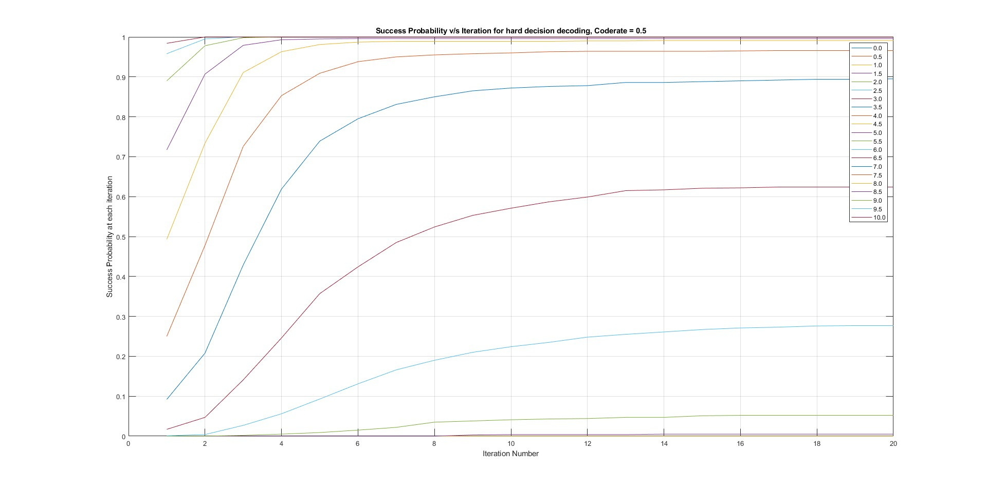
decoding success

Slide 41
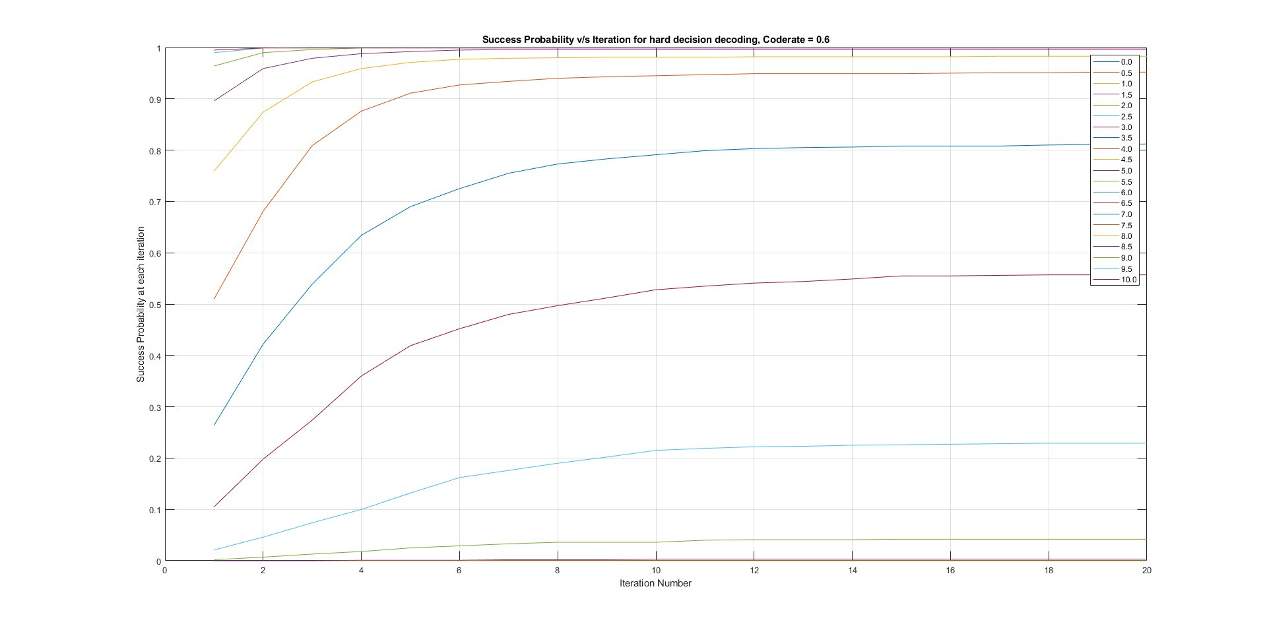
decoding success

Slide 42
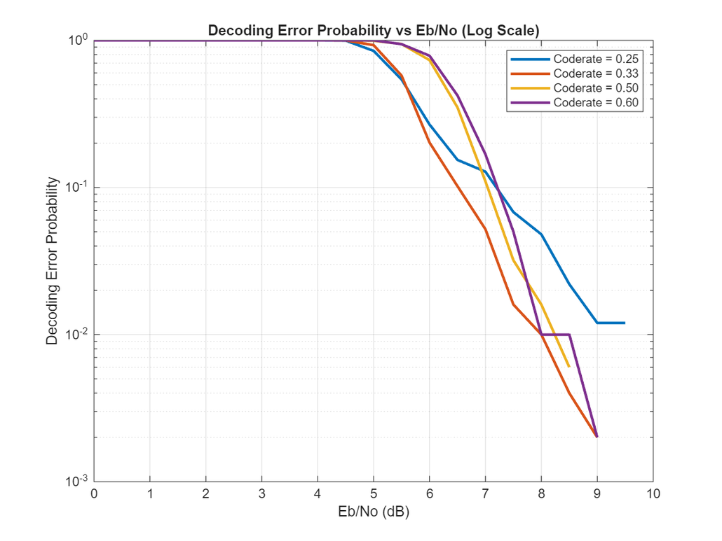
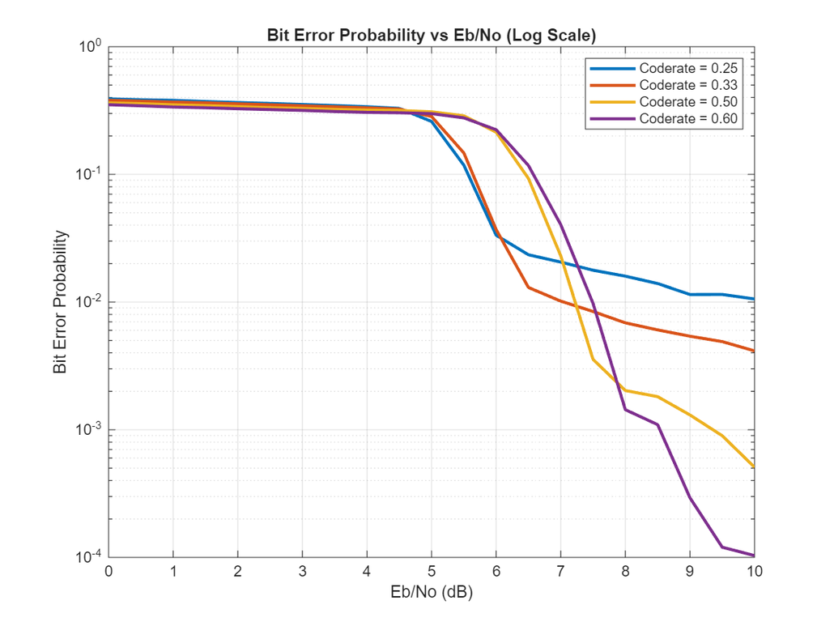
Overall HDD
(log scale)

Slide 43


wow.. facinating results on BG2
let’s try on BG1
but wait, will it work for lower code rates?
especially coderate like 1/4?
oh C’mon it’s matlab how
does it know whether we’r giving higher
or lower coderates

Slide 44

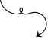
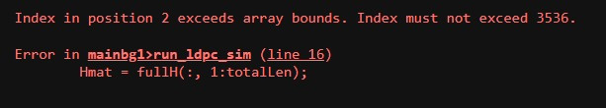

but here is...
a catch....
This is what we’ve found
when we tried to run code for BG1
for coderate = 1/4
not only theoretically but practically BG1 really works for higher code rate only...

Slide 45
Results of Soft Decision Decoding
for Matrix
NR_2_6_52

Slide 46
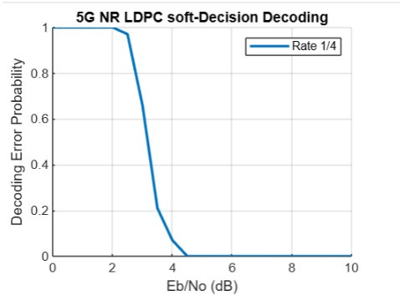
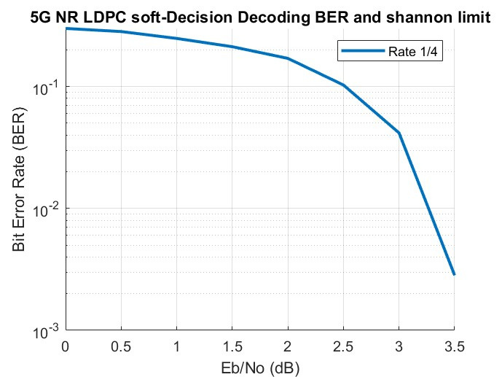
Rate = 1/4

Slide 47
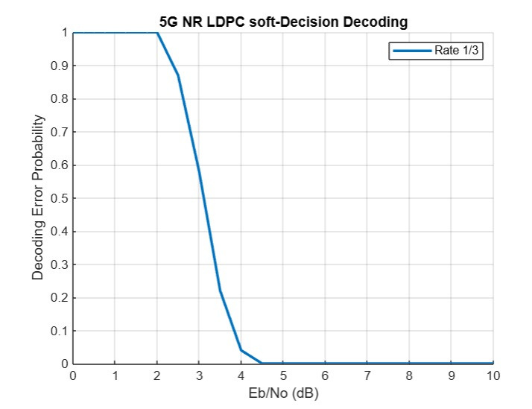

Rate = 1/3

Slide 48


Rate = 1/2

Slide 49


Rate = 3/5

Slide 50

decoding success for rate 1/4

Slide 51

decoding success for rate 1/3

Slide 52

decoding success for rate 1/2

Slide 53

decoding success for rate 3/5

Slide 54
Conclusion

Slide 55


BER comparison between Hard and soft decision decoding
Bit error rate reduces significantly when the value of Eb/No increases above 5
The value of BER approaches zero at a much lower Eb/No value, approximately 3.1, which implies that soft decision decoders work better at lower SNRs.

Slide 56


Decoding error probability comparison between Hard and soft decision decoding
Decoding error probability reduces significantly when the value of Eb/No increases above 5
Comparatively, in this case, the decoding error probability reduces drastically when Eb/No increases beyond 2
From the above graphs, we can conclude that with lower code rate, channel efficiency increases, for lower code rates, no. of parity bits increases which makes the decoding more reliable.

Slide 57

Comparison with Normal Approximation And Shannon Limit
From the above graph, we can see that the BLER value is very low (10-5 or less) when the value of Eb/no is greater than or equal to 2.
From our simulations of soft decision decoding, we found that BER achieves such lower values when Eb/No is greater than or equal to 3.1 (approx.), which is close to the result obtained from normal approximation.

Slide 58

Comparison with Normal Approximation And Shannon Limit

Slide 59
To sum it up...
So, from all the previous discussion, we can conclude the following:
For lower SNR values or when we cannot afford losing any message bit, we should use soft decision decoding, as it is more efficient as compared to hard decision decoding.
However, soft decision decoding has higher complexity compared to hard decision decoding and at higher values of SNRs both decoding methods show nearly the same performance and hence we prefer Hard decision decoding in that case.

Slide 60
References
Lecture slides of Channel Coding by Professor Yash Vasavda.
Implementation of Low-Density Parity-Check Codes for 5G NR shared channels by LIFANG WANG
Video lectures of NPTEL - NOM IITM by Prog. Andrew Thangaraj on LDPC codes.

Slide 61
Group members
Student ID | Name
202301179 | VAISHNAV POORVA MUKUL
202301180 | VALA SIDDHARTHSINH HARIBHAI
202301181 | PATEL PREXA JAYANTKUMAR
202301182 | SORATHIYA BRINDABEN DILIPBHAI
202301183 | MAKAVANA RAJKUMAR BHAMABHAI
202301186 | DONDA VED VIPULBHAI
202301187 | BHATIA NISARG MAHESHKUMAR
202301189 | DHOLA KRISH HARESHBHAI
202301190 | VALA HARDIK VINUBHAI

Slide 62


THANK YOU!

